Slide 1
Regression Analysis
Simple Linear Regression
Nicoleta Serban, Ph.D.
Professor
School of Industrial and Systems Engineering
Regression Concepts: Basics

Slide 2

About This Lesson

Slide 3
Example 1
A company, which sells medical supplies to hospitals, clinics, and doctor's offices, had considered the effectiveness of a new advertising program.
Management wants to know if the advertisement is related to sales.
This company intends to increase the sales with an effective advertising
program.

Slide 4
Data Example 1
The company observes for 25 offices the yearly sales (in thousands) and the advertisement expenditure for the new program (in hundreds)
Sales | ADV
963.50 | 374.27
893.00 | 408.50
1057.25 | 414.31
1183.25 | 448.42
1419.50 | 517.88
…

Slide 5
Example 2
The principle of purchasing power parity (PPP) states that over long periods of time exchange rate changes will tend to offset the differences in inflation rate between two countries.
In an efficient international economy, exchange rates would give each currency the same purchasing power in its own economy. Even if it does not hold exactly, the PPP model provides a benchmark to suggest the levels that exchange rates should achieve.

Slide 6
Data Example 2
The data are recorded for 41 countries, including both developed and developing countries. The data include the following columns.
Country | Inflation.difference | Exchange.rate.change | Developed
Australia | -1.2351 | -3.1870 | 1
Austria | 1.5508 | 1.4781 | 1
Belgium | 1.0371 | 0.0395 | 1
Canada | 0.0461 | -1.6416 | 1
Chile | -18.4126 | -20.6329 | 0

Slide 7
Example 3
In 2000 Bush and Gore were the main candidates for President in the U.S. Buchanan, a strongly conservative candidate, was also on the ballot. In the state of Florida, Bush and Gore essentially tied, hence the counts were examined carefully county by county.
Palm Beach County exhibited strange results. Even though the people in this county are not conservative, many votes were cast for Buchanan. Examination of the voting ballot revealed that it was easy to mistakenly vote for Buchanan (a conservative candidate) when intending to vote for Gore. We will thus predict whether those who voted for Buchanan were indeed going for a conservative candidate.
The data file includes many other variables characterizing the counties. We will focus only on the number of votes in this analysis.

Slide 8
Variables in Regression
The regression framework is characterized by the following:
We have one particular variable that we are interested in understanding or modelling, such as sales of a particular product, or the stock price of a publicly traded firm. This variable is called the response (dependent) variable, and is usually represented by Y.
We have a set of other variables that we think might be useful in predicting or modelling the response variable (say the price of the product, the competitors’ price, and so on; or the profits, revenues, financial position of the firm, and so on). These are called the predicting or explanatory (independent) variables, and are usually represented by x1, x2, etc.

Slide 9
Variables in Regression
RESPONSE VARIABLE versus PREDICTING VARIABLE?
Response Variable: It is a Random Variable. It varies with changes in the predictor/s along with other random changes.
Predicting Variable: It is a Fixed Variable. It does not change with the response, but it is set fixed before the response is measured.

Slide 10
Response vs Predicting Variable
The effect of several types of cholesterol medications on LDL levels in humans.
  Response Variable: Change in LDL levels
  Predicting Variable: Type of Medication
The relationship between driving habits and fuel efficiency
  Response Variable: Miles Per Gallon (MPG) of Fuel
  Predicting Variable: Average Driving Speed
The relationship between college grade point average (GPA) and scores on the SAT
  Response Variable: GPA
  Predicting Variable: SAT score

Slide 11
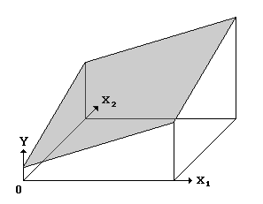
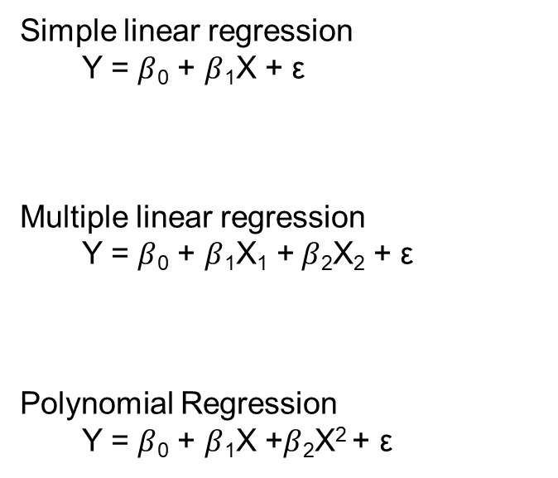
Linear Regression: General Model
.
Simple linear regression
Y = $β$₀ + $β$₁X + $\text{ε}$
Multiple linear regression
Y = $β$₀ + $β$₁X₁ + $β$₂X₂ + $\text{ε}$
Polynomial Regression
Y = $β$₀ + $β$₁X +$β$₂X² + $\text{ε}$
.
.
.
.
.
.
.
.
.
.
.

Slide 12
Linear Regression: General Model
.
Simple linear regression
Y = $β$₀ + $β$₁X + $\text{ε}$
Multiple linear regression
Y = $β$₀ + $β$₁X₁ + $β$₂X₂ + $\text{ε}$
Polynomial Regression
Y = $β$₀ + $β$₁X +$β$₂X² + $\text{ε}$
.
.
.
.
.
Whether a linear or polynomial model in X, we can estimate the relationship using linear regression.
.
.
.
.
.
.

Slide 13
Regression: Basics
A regression analysis is used for:
Prediction of the response variable;
Modelling the relationship between the response variable and the explanatory variables; or
Testing hypotheses of association relationships.
Linear Regression: The basis of what we will be talking about most of this course is the linear model. Virtually all other methods for studying dependence among variables are variations on the idea of linear regression.
All models are wrong, but some are useful. George Box
Embrace your data, not your models. John Tukey
“
”
“
”

Slide 14

Summary

